Slide 1

ASP.Net Core
Nobel It solutions

Slide 2
ASP.Net Core
What is ASP.Net Core?
ASP.NET Core is an open source and cloud-optimized web framework for developing modern web applications that can be developed and run on Windows, Linux and the Mac. It includes the MVC framework, which now combines the features of MVC and Web API into a single web programming framework.
ASP.NET Core apps can run on .NET Core or on the full .NET Framework.
It was architected to provide an optimized development framework for apps that are deployed to the cloud or run on-premises.
It consists of modular components with minimal overhead, so you retain flexibility while constructing your solutions.
You can develop and run your ASP.NET Core apps cross-platform on Windows, Mac and Linux.

Slide 3
Advantages of ASP.Net Core
ASP.NET Core has a number of architectural changes that result in a much leaner and modular framework.
ASP.NET Core is no longer based on System.Web.dll. It is based on a set of granular and well factored NuGet packages.
This allows you to optimize your app to include just the NuGet packages you need.
The benefits of a smaller app surface area include tighter security, reduced servicing, improved performance, and decreased costs.

Slide 4
Get Improvement with ASP.Net Core
Build and run cross-platform ASP.NET apps on Windows, Mac and Linux.
Built on .NET Core, which supports true side-by-side app versioning.
New tooling that simplifies modern Web development.
Single aligned web stack for Web UI and Web APIs.
Cloud-ready environment-based configuration.
Built-in support for dependency injection.
Tag Helpers which makes Razor markup more natural with HTML.
Ability to host on IIS or self-host in your own process.

Slide 5
ASP.Net Core Template
Connected Services: The 'Connected Services' node contains the list of external services, APIs, and other data sources. It helps in the integration with various service providers, such as Azure, AWS, Google Cloud, and third-party services like authentication providers or databases. We are not using any service yet so it will be empty for now.
Properties : The Properties folder contains the file launchSettings.json. This json file contains all the project-specific settings needed to launch the application. You will find debug profile, environment variables that should be used, etc in this file.
Dependencies: This folder contains all the Dependencies of the project. The Visual studio uses NuGet Packages for all the server-side dependencies. For the Client-Side dependencies, the Libman is used. This is a deviation from the previous versions where NuGet is used for both for Server & Client-side dependencies. Under the Dependencies folder, we have Packages, Frameworks & Analyzers folder.
Program.cs File: The Program class contains the entry point of the ASP.NET Core applications. There is no main method in this file. It is implicit. All the tasks which was done in startup class, is now moved here starting from version .NET 6.0. We configure the applications request pipeline & Middlewares in the program.cs. We also configure the services and add them to the dependency injection container.
The default program.cs file from .NET 6.0 and above.

Slide 6
ASP.Net Core Template
Appsettings.json : The appsettings.json file is a configuration file commonly used in .NET applications, including ASP.NET Core and ASP.NET 5/6, to store application-specific configuration settings and parameters. It allows developers to use JSON format for the configurations instead of code, which makes it easier to add or update settings without modifying the application's source code.

Slide 7
Middleware
ASP.NET Core introduced a new concept called Middleware. A middleware is nothing but a component (class) which is executed on every request in ASP.NET Core application. In the classic ASP.NET, HttpHandlers and HttpModules were part of request pipeline. Middleware is similar to HttpHandlers and HttpModules where both needs to be configured and executed in each request.
There will be multiple middleware in ASP.NET Core web application. It can be either framework provided middleware, added via NuGet or your own custom middleware. We can set the order of middleware execution in the request pipeline. Each middleware adds or modifies http request and optionally passes control to the next middleware component. The following figure illustrates the execution of middleware components.

Slide 8
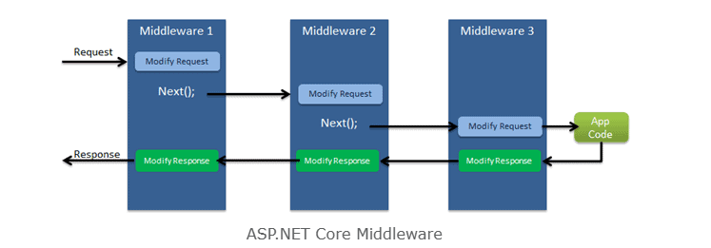
Middleware

Slide 9
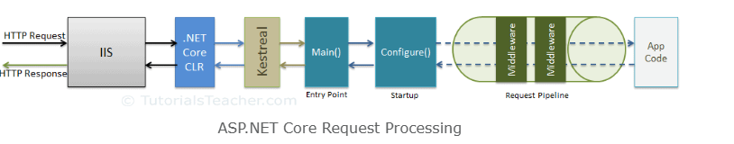
Middleware Request Processing

Slide 10
Middleware
Middleware are software components that are assembled into an application pipeline to handle requests and responses.
Each component chooses whether to pass the request on to the next component in the pipeline, and can perform certain actions before and after the next component is invoked in the pipeline.
Request delegates are used to build the request pipeline. The request delegates handle each HTTP request.
Each piece of middleware in ASP.NET Core is an object, and each piece has a very specific, focused, and limited role.
Ultimately, we need many pieces of middleware for an application to behave appropriately.

Slide 11
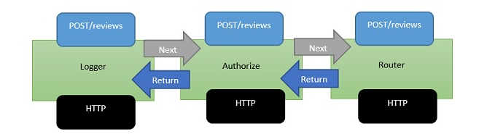
Example of Middleware

Slide 12
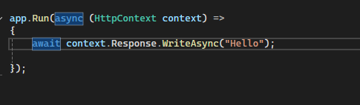
App.Run()
The extension method called Run is used to execute a terminating/short circuiting middleware that does not forward the request to next middleware.
The Run method allows us to pass in another method, which we can use to process every single response. Run is not something that you will see very often, it is something that we call a terminal piece of middleware.

Slide 13
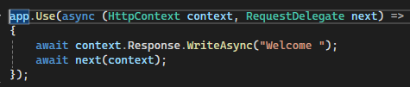
App.Use()
The extension method called 'Use' is used to execute a non-terminating /short-circuiting middleware that may /may not forward the request to next middleware.

Slide 14
Middleware Class
Middleware class is used to separate the middleware logic from lambda expression to a separate/reusable class.
The custom middleware component is like any other .NET class with Invoke() method. However, in order to execute next middleware in a sequence, it should have RequestDelegate type parameter in the constructor.

Slide 15
Environment
An environment represents is a system in which the application is deployed and executed.
Development: The environment where the developer makes changes in the code, commits code to the source control.
Staging: The environment, where the application runs on a server from which other developers and quality controllers access the application.
Production: The environment where the real end-users access the application. Shortly, It's where the application "live" to the audience.

Slide 16
Properties & Methods
EnvironmentName: Gets or sets name of the environment. By default it reads the value from either DOTNET_ENVIRONMENT or ASPNETCORE_ENVIRONMENT.
ContentRootPath: Gets or sets absolute path of the application folder.
IsDevelopment(): Returns Boolean true, if the current environment name is "Development".
IsStaging(): Returns Boolean true, if the current environment name is "Staging".
IsProduction(): Returns Boolean true, if the current environment name is "Production".
IsEnvironment(string environmentname): Returns Boolean true, if the current environment name matches with the specified environment.

Slide 17
Routing
Routing is a process of matching incoming HTTP requests by checking the HTTP method and url and then invoking corresponding endpoints.
Key components of routing in ASP.NET Core
Route Template: A route template defines the structure of a URL and includes placeholders for route values. For example, /products/{id} is a route template with a placeholder {id}.
Route Values: Route values are extracted from the URL based on the placeholders defined in the route template. In the above example, id is a route value.
Route Constraints: Constraints are used to restrict which URLs match a route template. For instance, you can constrain id to only match numeric values.
Route Parameters: Route parameters are placeholders in controller action methods that correspond to route values. They receive values from the route values extracted from the URL.

Slide 18
RouteParamater, Default Parameters & Optional Parameter
Route Parameters is ready to accept any parameter at run time
Route parameter can match with any value.
Default Parameter: A route parameter with default value matches with any value. It also matches with empty value. In this case, the default value will be considered into parameter.
Optional Parameter: "?" Indicates an optional parameter. That means , it matches with a value or empty value also.

Slide 19
GetEndpoint() & UseEndPoints()
GetEndpoint(): Returns an instance of Microsoft.AspNet.Core.Http.Endpoint type, which represents an endpoint. That instance contains two important properties:DisplayName,RequestDelegate
UseEndPoints(): Executes the approriate endpoint based on the endpoint selected by the above UseRouting() method.

Slide 20
Route Constraints part-1
Int: Matches with any integer
E.g. {id:int?}
Bool: Matches with true or false value. Case-insensitive.
E.g. {active:bool} matches with true false, TRUE, FALSE
Datetime: Matches a valid DateTime value with formats "yyyy-MM-dd hh:mm:ss tt" and "MM/dd/yyyy hh:mm:ss tt"
E.g. {id:datetime?} matches with 2030-01-01%2011:59%20pm (Note-%20 is equal to space)
Decimal: Matches with a valid decimal value
{price:decimal} matches with 44.99,-9,0.03

Slide 21
Route Constraints part-2
Long: Matches with valid long value
E.g. {id:long} maches with 123456789,-123456789
Guid: Matches with a valid Guid value (Global unique Identifier-A hexadecimal number that is universally unique)
E.g. {id:guid} matches with 123E4567-E89B-12D3-A456-4244562340000

Slide 22
Route Constraints part-3
Minlength(value) :Matches with a string that has at least specified number of characters. Eg. {username:minlength(4)} matches with John, Yash, Rita
Maxlength(value) :Matches with a string that has less than or equal to the specified number of characters. Eg. {username:maxlength(8)} matches with John, Yash, William
Length(min,max): Matches with a string that has number of characters between given minimum and maximum length(both numbers including). Eg. {username:length(4,8)} matches with John, Yash, William
Length(value): Matches with a string that has exactly specified number of characters. E.g. {tin:length(9)} matches 987654321
Min(value):Matches with a integer value greater than or equal to the specified value. E.g. {age:min(18)} matches 18,19,100

Slide 23
Route Constraints part-3
Max(value):Matches with a integer value less than or equal to the specified value. E.g. {age:max(100)} matches –1,1,85,19,100
Range(min,max): Matches with a integer value between the specified minumum and maximum values(both numbers including). E.g. {age:range(1,100)} matches 1,85,19,100
Alpha: Matches with a string that contains only alphabets (A-Z) and (a-z).
E.g. {username:alpha} matches with rick, william
Regex(expression): Matches with a string that matches with the specified regular expression.
Eg1.{age:regex(^[0-9]{2}$)} matches with any two-digit number, such as 10,98,87
E.g2. {age:regex(^\d{3}-\d{3}$)} matches with any three-digit number , then hyphen and then three digit number such as 123-456

Slide 24
Endpoint selection order
URL template with more segments
Ex. "a/b/c/d" is higher than "a/b/c"
URL template with literal text has more precedence than a parameter segment.
Ex. "a/b" is higher than "a/{parameter}".
URL template that has a parameter segment with constraints has more precedence than a parameter segment without constraints.
Ex. "a/{b}:int" is higher than "a/{b}"
Catch all parameters(**)
Ex."a/b" is higher than "a/**"

Slide 25
Services
Service is a class that contains business logic such as business calculations business validations that are specific to the domain of the client's business.
Service is an abstraction layer(middle layer) between presentation layer(or application layer) and data layer.
It makes the business logic separated from presentation layer and data layer.
It makes the business logic to be unit testable easily.

Slide 26
Dependency Problem
Higher-level modules depend on lower-level modules. Means both are tightly coupled.
The developer of higher-level module Should wait until the completion of development of lower-level module.
Any changes made in the lower-level module effect changes in the higher-level module.
Requires much code changes in to interchange an alternative lower-level module.
Difficult to test a single module without effecting/testing the other module.

Slide 27
Dependency Inversion Principle
Dependency Inversion Principle(DIP) is a design principle(guideline). Which is a solution for the dependency problem.
The higher-level modules(clients) Should not depend on low level modules(dependencies)
Both should depend on abstractions (interfaces or abstract class)
Abstractions should not depend on details(both client or dependency).
Details (both client and dependency) should depend on abstractions.

Slide 28
Inversion of Control(IoC)
Inversion of control(IoC) is a design pattern(reusable solution for a common problem), which suggests "IoC container" for implementation of dependency Inversion Principle (DIP)
It inverses the control by shifting the control to IoC container
"Don't call us, we will call you" pattern.
It can be implemented by other design patterns such as events, service locator, dependency injection
All dependencies should be added into the IServiceCollection(acts as IoC container).

Slide 29
Dependency Injection/Method Injection
Dependency injection(DI) is a design pattern, which is a technique for achieving "inversion of Control(IoC)" between clients and their dependencies.
It allows you to inject(supply) a concrete implementation object of a low level component into high level component.
The client class receives the dependency object as a parameter either in the constructor or in a method.

Slide 30
Transient, Scoped & Singleton Services
Service Lifetime in DI- A service lifetime indicates when a new object of the service has to be created by the IoC/ DI container.
Transient: per injection. Transient lifetime service objects are created each time when they are injected.
Service instances are disposed at the end of the scope (usually, a browser request)
Scoped : per scope (browser request).Scoped lifetime service objects are created once per a scope(usually, a browser request)
Service instances are disposed at the end of the scope (usually, a browser request).
Singleton: for entire application lifetime. Singleton lifetime service objects are created for the first time when they are requested.
Service instances are disposed at application shutdown.

Slide 31
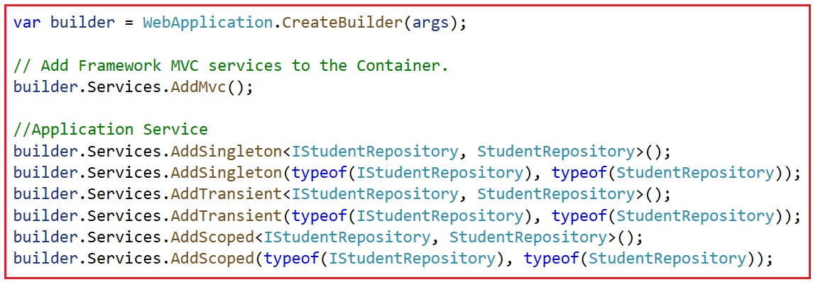
AddTransient(), AddScoped(), AddSingleton()

Slide 32
Configuration Settings
Configuration (or configuration settings) are the constant key/value pairs that are set at a common location and can be read from anywhere in the same application.
Example: connection strings, Client ID & API keys to make REST-API calls, Domain names, Constant email addresses etc.

Slide 33
Option Pattern
Option pattern uses custom classes to specify what configuration settings are to be loaded into properties.
Examples: Reading the specific connections strings out of many configuration settings.
The option class should be a non-abstract class with a public parameter less constructor.
Public read-write properties are bound fields are not bound

Slide 34
GetSection(string Key), Bind(object instance) & Get<T>
GetSection(string Key): Returns an IConfigurationSection based on the specified key.
Bind(object instance): Binds(loads) configuration key/value pairs into properties of the existing object.
Get<T>(): Binds(loads) configuration key/value pairs into new object of the specified type.

Slide 35
Environment specific Configuration
Appsettinggs.Development.json
Appsettings.Staging.json
Appsetting.production.json

Slide 36
Secret Manager
The secrets manager stores the user secrets(sensitive configuration data) in a separate location on the developer machine.
Enables Secrets Manager: in "Windows PowerShell" /"Developer PowerShell" in VS
Dotnet user-secrets init
Dotnet user-secrets set "Key" "Value"
Dotnet user-secrets list

Slide 37
Environment Variable configuration
You can set configuration values as in-process environment variables.
In "Windows PowerShell"/"Developer PowerShell" in VS.
$Env: ParentKey_ _ ChildKey="value"
Dotnet run -–no-luanch-profile
It is one of the most secured way of setting-up sensitive values in configuration.
__(underscore and underscore) is the separator between parent key and child key.

